Slide 1
1990’s Operating Systems

Slide 2
What is an Operating System and what did it do in the 1990s?
An Operating System (OS) is a system software which manages both hardware (physical) and software (digital) resources, allowing efficiency in the use of applications as to allow a computer to function effectively.
The Microsoft Disk OS (MS-DOS) was primarily used in the 1990s primarily in the early to mid years up until the appearance of Windows 95 then Windows 98 finally.
In the 1990s Graphical User Interfaces (GUIs) gained more popularity and started to be further incorporated into systems with the reducing costs of computers allowing households to acquire them.

Slide 3
Operating Systems used in the 1990s
Unix was still in use during the early years of the 1990s
Windows 3.0 was developed in 1990, compatible with the Microsoft Disk OS (MS-DOS) gaining popularity.
Linux was developed in 1991, introducing open source development
Mac OS (System 7) developed in 1991
Windows 95 was released in 1995 replacing the 3.X systems, gaining massive popularity, system could integrate MS-DOS and Windows
Mac OS 8 developed in 1997
Windows 98 released in 1998, this replaced the 95 system, being able to support disk partitions greater than 2 GB
Mac OS 9 developed in 1999

Slide 4
Operating Systems value in the 1990s
Computers started become more commercial during the final years of the 19th century, the development of operating systems with GUIs built in (eg Windows 3.X, Windows 95 and 98, Mac OS 7/8/9) allowed ease of use replacing text with more easy to understand icons, reducing the barrier of understanding and access.
The Internet developed popularity in the 1990s with the invention of the World Wide Web in 1991 and operating systems beginning to bundle Internet support into their OS.
OS multi-tasking capabilities were quickly developing in the 1990s allowing multiple programs to run at once, helping business and individuals efficiency.

Slide 5
Conclusion
In Conclusion, the 1990s had a large development in ease of use, with the regulation of GUIs and the move away from the MS-DOS, furthermore the more common integration of the internet into OS developed business and individual relations in a positive direction

Slide 6
OPERATING SYSYTEMS IN 2000’S

Slide 7
What are operating systems
What is the Kernel
What is the shell
Operating Systems in the 2000’s
Windows Xp
Mac OS X
Ubuntu

Slide 8
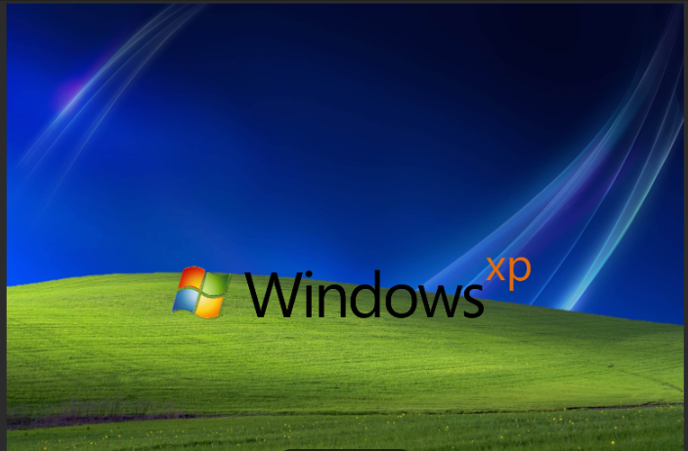
Introduce the lava style
Built on the Windows Nt kernel
More intuitive navigation and control panel layout.
End of life on April 14, 2009
Impact: Helped mainstream computing and brought PCs into more homes and schools globally.
Various Editions include
Windows xp home edition
Windows Xp professional
Windows xp Media center Edition

Slide 9
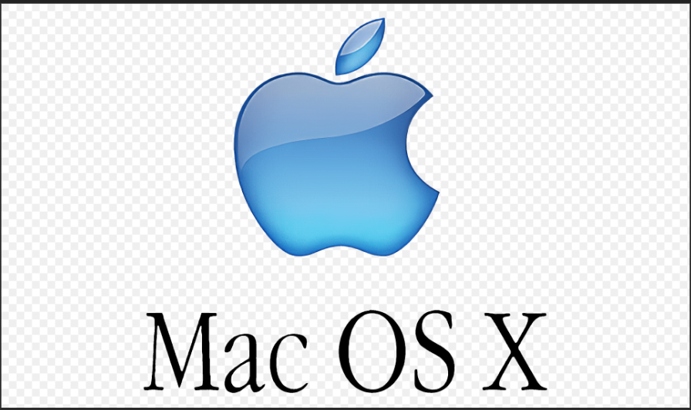
Aqua User Interface:
Clean, fluid design with features like translucent windows, drop shadows, and animated effects.
Use of dock for quick access to applications.
Stability & Security:
Protected memory and Unix foundations make it more secure and stable than classic Mac OS.
Less prone to crashes and viruses.
Multitasking & Performance:
True preemptive multitasking.
Efficient use of system resources.
Built-in Applications:
Safari (web browser), Mail, iTunes (now Apple Music), iMovie, iPhoto, Calendar, and more.
Impact: Made computers less intimidating and more stylish, especially for creatives and educators.

Slide 10
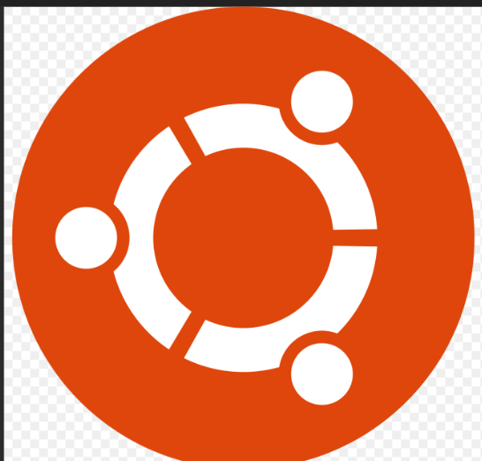
User-Friendly Interface:
Ubuntu uses the GNOME desktop environment (previously used Unity).
Graphical interface similar to macOS or Windows.
Comes with a software center for installing apps easily.
Free and Open Source:
No licensing fees.
Source code is freely available and modifiable.
Security and Stability:
Built on Linux, known for strong security.
Regular security patches and long-term support (LTS) releases.
Limited exposure to viruses and malware.
Preinstalled Applications:
Comes with free software: Firefox, LibreOffice, Thunderbird, Rhythm box, etc.
Supports thousands of apps via APT package manager and Snap Store.
Made Linux accessible to the masses and fostered a global community of open-source contributors.

Slide 11
In the 2000s, operating systems evolved from being complex, technical tools into user-friendly, stable platforms that made personal computing more accessible, reliable, and secure for everyone—from beginners to professionals.
CONCLUSION

Slide 12
OPERATING SYSTEMS IN THE 2020’S

Slide 13
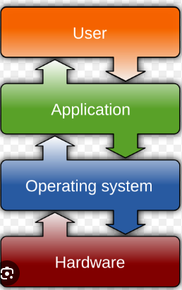
An Operating System In The 2020’s
It’s a software that manages hardware and software resources.
It acts as a bridge between the user and computer hardware.
Core functions: UI, memory management, process control, file system, device handling, security.

Slide 14
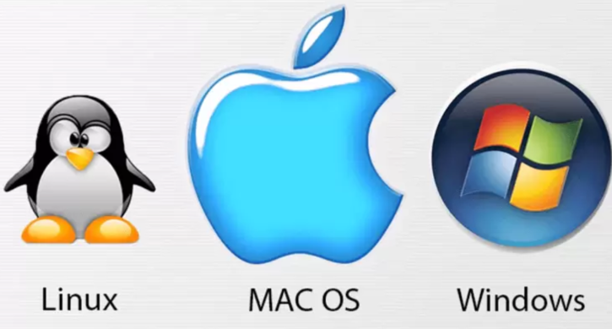
Desktop & Laptop OS In The 2020’s
Windows 10 / 11 – dominant globally, modern UI, Android app support.
macOS (Big Sur to Sequoia) – optimized for Apple Silicon (M1/M2/M3).
Linux – used by developers, popular distros: Ubuntu, Fedora, Linux Mint.

Slide 15
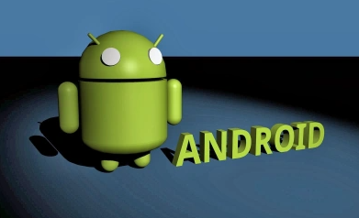
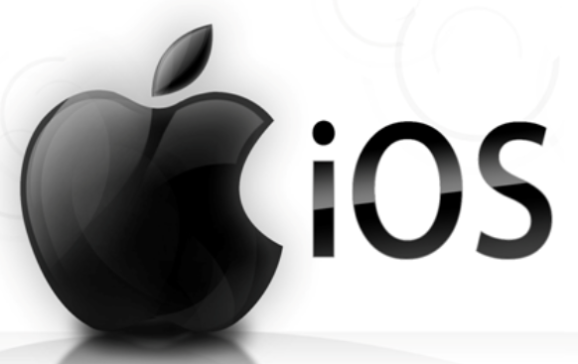
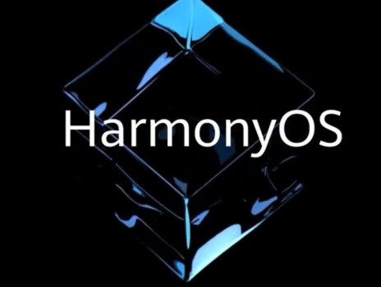
Mobile Operating Systems
Android – most used globally, highly customizable.
iOS – privacy focused, tightly integrated with Apple ecosystem.
HarmonyOS – Huawei’s alternative to Android, mainly in China.

Slide 16

Emerging & Specialized OS
ChromeOS – cloud-based, popular in schools.
Fuchsia OS – Google’s experimental future OS.
RTOS (Real-Time OS) – used in IoT and embedded systems.

Slide 17

Trends In The 2020’s
Cloud-native features and storage.
Enhanced security & privacy protections.
Rise of AI integration (e.g., Windows Copilot, Apple Intelligence).
Cross-device and ecosystem connectivity.

Slide 18
Conclusion
OS in the 2020s are more intelligent, secure, and connected.
Shift toward cloud, mobility, and AI-first design.
Ongoing evolution across devices from desktops to wearables and beyond.

